Slide 1
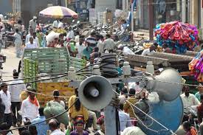
NOISE POLLUTION
Sources , Causes, Effects and Remedial measures
Presented by:
Shubham Panchal ( 10167 )
Vishal Patil ( 10168 )
Kaustubh Netke ( 10169 )

Slide 2
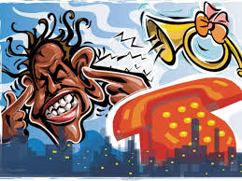
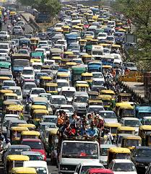
Have you ever got anxious after hearing the harsh sound of vehicles in traffic or drilling sound from municipality construction site or high volume speakers of Brass Band or DJ?
If yes then you can understand how BIG PROBLEM the NOISE POLLUTION is and how it affects our day – to – day life and that’s why we need to study it and not just study but apply our knowledge to solve it as a responsible ENGINEER of society!

Slide 3
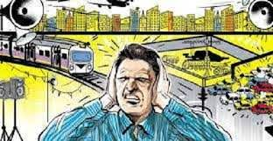
WHAT IS NOISE POLLUTION ?
According to Britannica, noise pollution is unwanted or excessive sound that can have deleterious effects on human health, wildlife, and environmental quality. Noise pollution is commonly generated inside many industrial facilities and some other workplaces, but it also comes from highway, railway, and airplane traffic and from outdoor construction activities.
It’s also known as environmental noise and it occurs through the propagation of noise with frequency range dangerous to humans as well as animals.

Slide 4
What are the sources of noise pollution ?
Noise pollution like other pollutants is also a by- product of industrialization, urbanizations and modern civilization. Broadly speaking , the noise pollution has two sources, i.e. industrial and non- industrial.
The industrial source includes the noise from various industries and big machines working at a very high speed and high noise intensity.
Non- industrial source of noise includes the noise created by transport/vehicular traffic and the neighborhood noise generated by various noise pollution can also be divided in the categories , namely, natural and manmade.
Most leading noise sources will fall into the following categories: roads traffic, aircraft, railroads, construction, industry, noise in buildings, and consumer products.

Slide 5
1. Road Traffic Noise:
In the city, the main sources of traffic noise are the motors and exhaust system of autos , smaller trucks, buses, and motorcycles. This type of noise can be augmented by narrow streets and tall buildings, which produce a canyon in which traffic noise reverberates.
Ex: Pune-Satara Road, where there are buildings on either sides of the road.
2. Air Craft Noise:
Now-a-days , the problem of low flying military aircraft has added a new dimension to community annoyance, as the nation seeks to improve its nap-of the- earth aircraft operations over national parks, wilderness areas , and other areas previously unaffected by aircraft noise has claimed national attention over recent years.
Ex: Areas like Viman Nagar and J. P. Nagar in Pune where aircrafts operate.

Slide 6
3. Noise from railroads:
The noise from locomotive engines, horns and whistles, and switching and shunting operation in rail yards can impact neighboring communities and railroad workers. For example, rail car retarders can produce a high frequency, high level screech that can reach peak levels of 120 dB at a distance of 100 feet, which translates to levels as high as 138, or 140 dB at the railroad worker’s ear.
Ex: Chawls or small houses in Mumbai which are made just besides the railway track.
4. Construction Noise:
The noise from the construction of highways , city streets , and buildings is a major contributor to the urban scene . Construction noise sources include pneumatic hammers, air compressors, bulldozers, loaders, dump trucks (and their back-up signals), and pavement breakers.

Slide 7
5. Noise in Industry:
Although industrial noise is one of the less prevalent community noise problems, neighbors of noisy manufacturing plants can be disturbed by sources such as fans, motors, and compressors mounted on the outside of buildings Interior noise can also be transmitted to the community through open windows and doors, and even through building walls. These interior noise sources have significant impacts on industrial workers, among whom noise- induced hearing loss is unfortunately common.
Ex: Forging factories in MIDC Bhosari where a huge amount of noise is generated due to die-punch machines.
6. Noise in building:
Apartment dwellers are often annoyed by noise in their homes, especially when the building is not well designed and constructed. In this case, internal building noise from plumbing, boilers, generators, air conditioners, and fans, can be audible and annoying.

Slide 8

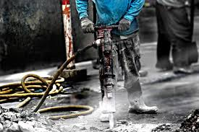
Improperly insulated walls and ceilings can reveal the sound of-amplified music, voices, footfalls and noisy activities from neighboring units. External noise from emergency vehicles, traffic, refuse collection, and other city noises can be a problem for urban residents, especially when windows are open or insufficiently glaze
7. Noise from Consumer products:
Certain household equipment, such as vacuum cleaners and some kitchen appliances have been and continue to be noisemakers, although their contribution to the daily noise dose is usually not very large.

Slide 9
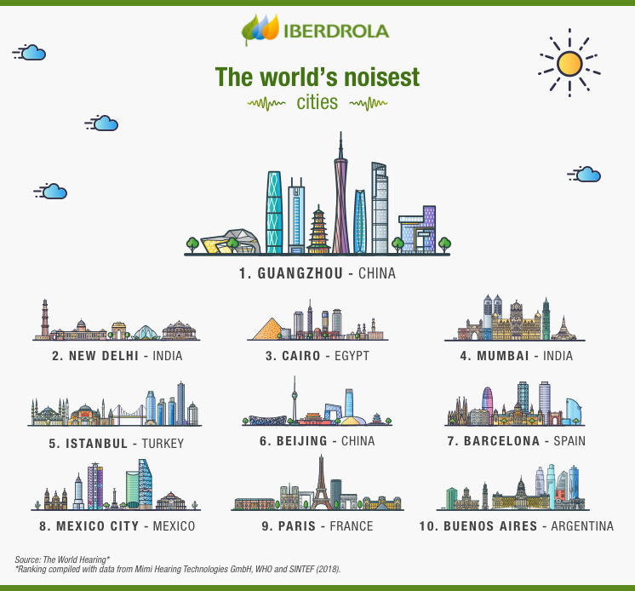
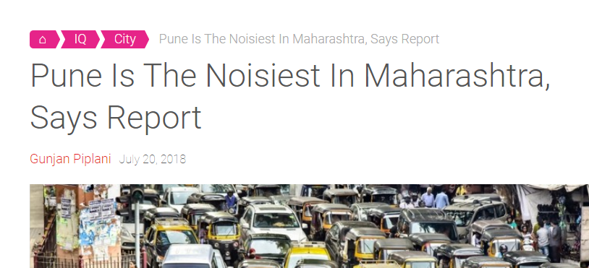
WHAT ARE CAUSES AND EFFECTS OF SOUND POLLUTION ?
Causes of Noise pollution in Delhi

Slide 10
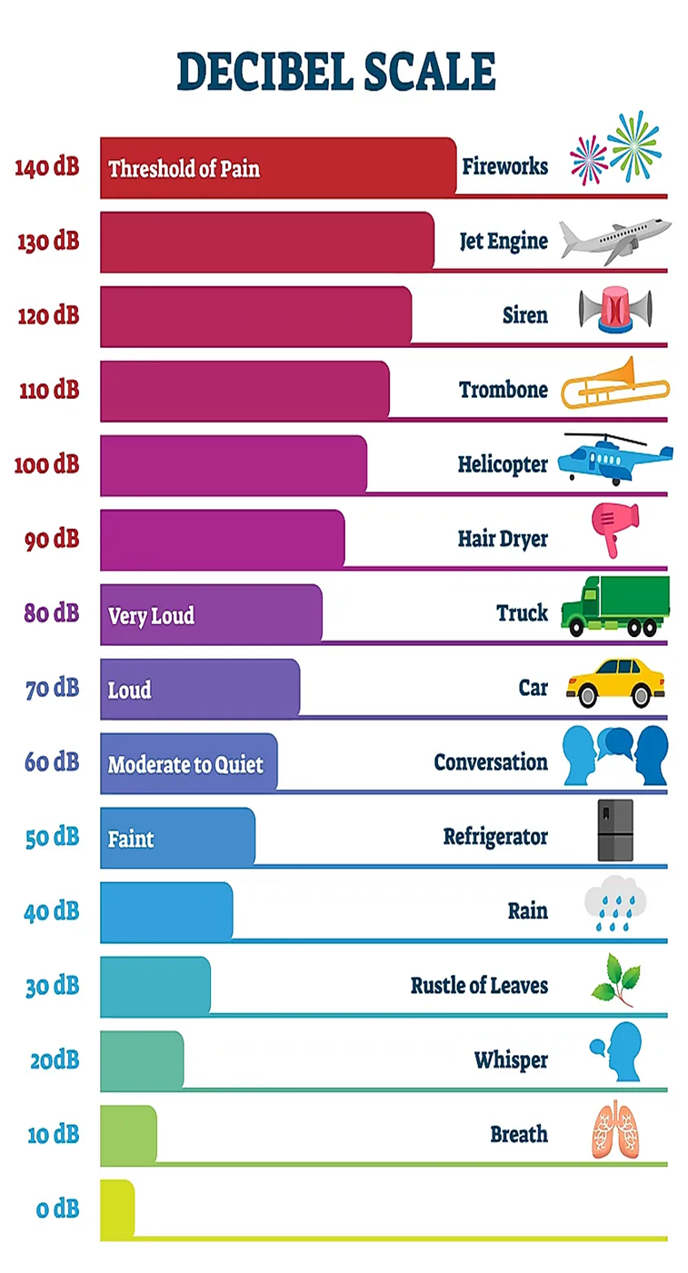
Effects of noise pollution
Noise has always been with the human civilization but it was never so obvious, so intense, so varied & so pervasive as it is seen in the last of this century. Noise pollution makes men more irritable. The effect of noise pollution is multifaceted & inter related. The effects of Noise Pollution on Human Being, Animal and property are as follows:
1) It decreases the efficiency of a man:- Regarding the impact of noise on human efficiency there are number of experiments which print out the fact that human efficiency increases with noise reduction

Slide 11
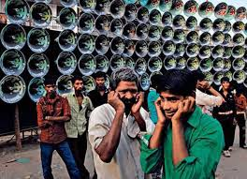
A study by Sinha & Sinha in India suggested that reducing industrial booths could improve the quality of their work. Thus human efficiency is related with noise.
2) Lack of concentration:- For better quality of work there should be concentration , Noise causes lack of concentration. In big cities , mostly all the offices are on main road. The noise of traffic or the loud speakers of different types of horns divert the attention of the people working in offices.
3) Fatigue:- Because of Noise Pollution, people cannot concentrate on their work. Thus they have to give their more time for completing the work and they feel tiring.

Slide 12
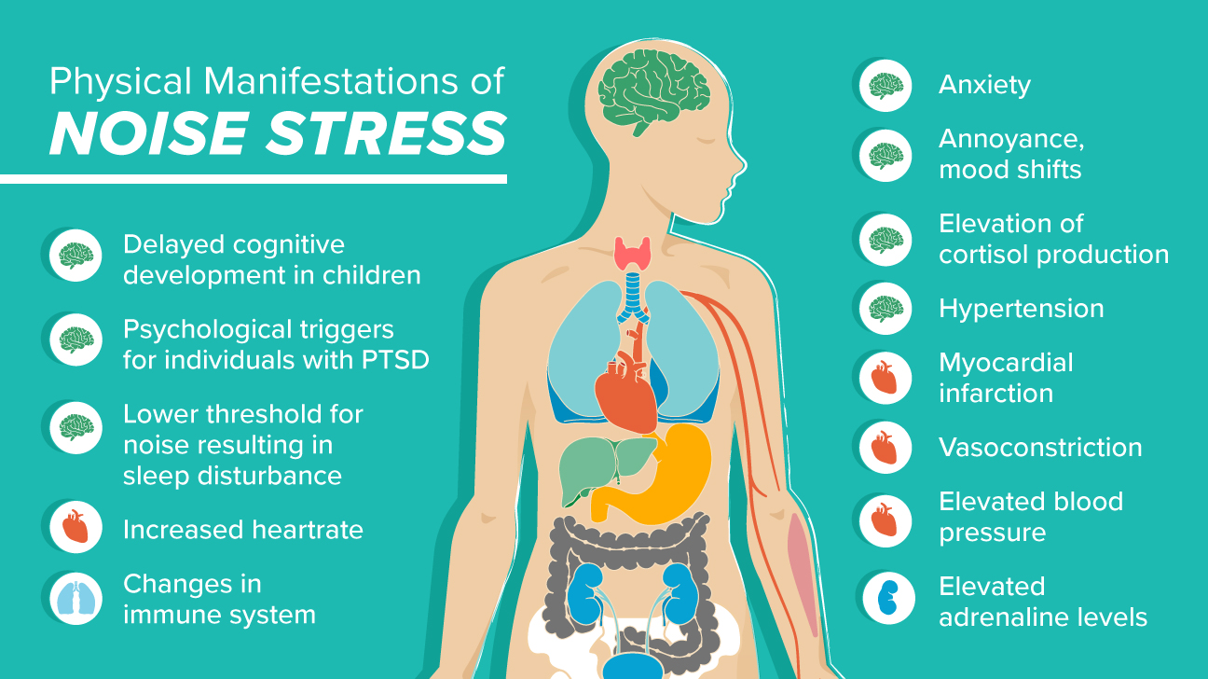
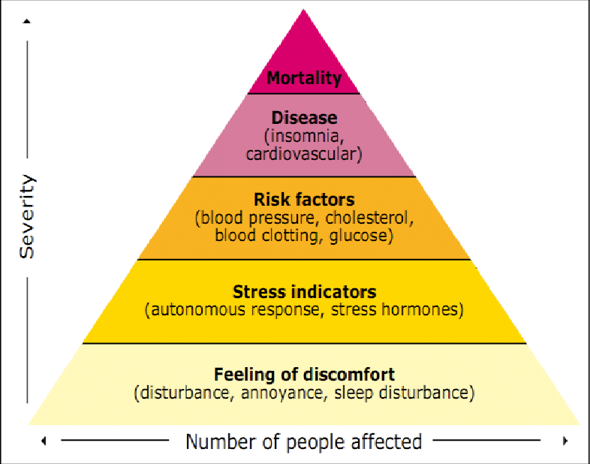
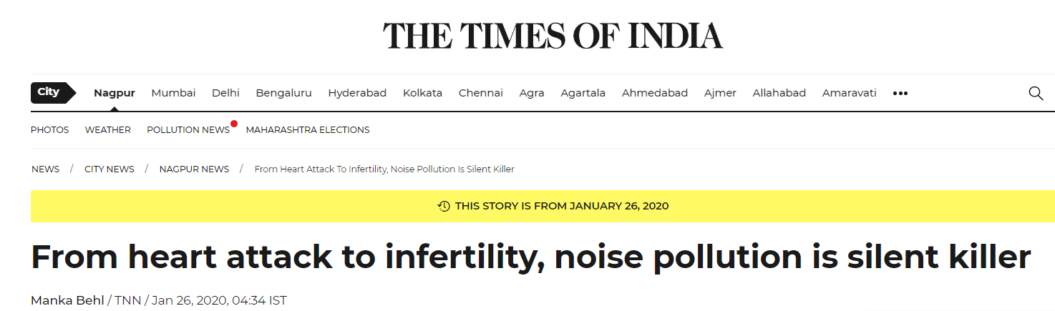
Effects of Noise Pollution on humans
WHO pyramid of effects of noise pollution

Slide 13

4) Abortion is caused: - There should be cool and calm atmosphere during the pregnancy. Unpleasant sounds make a lady of irritative nature. Sudden Noise causes abortion in females.
5) It causes Blood Pressure: - Noise Pollution causes certain diseases in human. It attacks on the person’s peace of mind. The noises are recognized as major contributing factors in accelerating the already existing tensions of modern living. These tensions result in certain disease like blood pressure or mental illness etc.
6) Temporary of permanent Deafness:- The effect of nose on audition is well recognized. Mechanics , locomotive drivers, telephone operators etc. All have their hearing . Impairment as a result of noise at the place of work. Physicist, physicians & psychologists are of the view that continued exposure to noise level above. 80 to 100 db is unsafe, Loud noise causes temporary or permanent deafness

Slide 14

7) EFFECT ON VEGETATION POOR QUALITY OF CROPS:- Now is well known to all that plants are similar to human being. They are also as sensitive as man. There should be cool & peaceful environment for their better growth. Noise pollution causes poor quality of crops in a pleasant atmosphere.
8) EFFECT ON ANIMAL:- Noise pollution damage the nervous system of animal. Animal looses the control of its mind. They become dangerous.
9) EFFECT ON PROPERTY:- Loud noise is very dangerous to buildings, bridges and monuments. It creates waves which struck the walls and put the building in danger condition. It weakens the edifice of buildings.

Slide 15
WHAT ARE REMEDIAL MEASURES FOR NOISE POLLUTION ?
Got tired of lot of theory let’s go through a video!
Click here
Let’s see what engineers from across the globe doing to tackle the problem.
Click here

Slide 16
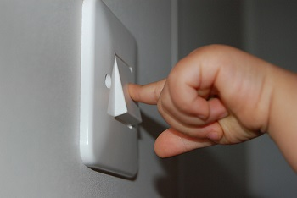
SOLUTIONS
1) Turn off Appliances at Home and offices :
Turn off home office appliances
We can turn off home and office appliances when not in use such as TV, games, computers etc. it can create unnecessary stress on ears. We can save electricity also when we turn them off.
2) Allowing higher noise levels only during certain time of the day:
Using loudspeakers or any other devices which produce high levels of sound should be prohibited for a certain period in a day, like in the nightime.

Slide 17


3) Use Earplugs/Earmuffs :
Use of earplugs or earmuffs can bring down loud noises to a manageable level. Earplugs are small inserts that fit into our ear canal. And earmuffs fit over the entire outer ear to form an air seal keeping ears safe from loud noises.
4) Lower the Volume :
We can listen to songs, radios, TVs in lower volume when listening from headphones or speakers. Higher volume can damage our eardrum.

Slide 18
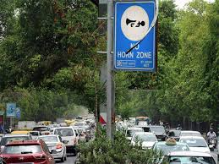
5) Stay away from Noisy area :
Noise producing industries, airports, vehicles should be far from residential areas as it is very dangerous for infants and senior citizens.
6) Follow the Limits of Noise level :
Community law should check the use of loudspeakers, outdoor parties as well as political public announcements.
7) Control Noise level near sensitive areas :
There should be control on noise level (Silent zones) near schools, traffic signals, hospitals. Place noise limits boards near sensitive areas.

Slide 19
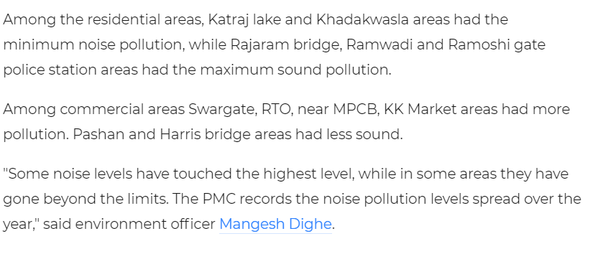
In Pune, …

Slide 20


8) Go Green by planning trees :
We can plant more trees as they are good noise absorbents. According to studies, it can reduce noise by 5 to 10 decibels around them.
9) Create Healthy noise to eliminate unwanted noise :
If we can’t eliminate unwanted noise coming from outside then we can create healthier noise such as music, singing birds or waterfalls in homes or offices.
10 ) Use Noise absorbents in noisy machineries :
We can check for pieces of machinery which are creating noise due to vibrations and put some noise absorbents to reduce noise.

Slide 21


11) Use Proper Lubrication and Better maintenance :
We can use proper lubrication as well as better maintenance of machines to reduce noise pollution and improve efficiency. It reduces friction between movable parts and helps to reduce noise.
12) Notify Authorities about Disobedience of Noise Rules :
We can notify government agencies if someone is not following rules and regulation regarding noise levels.
13) Regularly check noise levels :
Regularly checking noise level in an industrial complex and indoor to keep noise level within the limit.

Slide 22

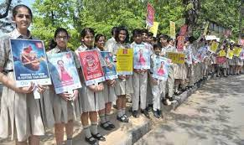
14) Government regulation and public awareness :
As per as ill effects of Noise Pollution are concerned our Government is serious For controlling it and thus we have Noise Pollution Act 2000. Objective of the Noise Pollution (Regulation & Control) Rules,2000- to regulate and control noise producing and generating sources with the objective of maintaining the ambient air quality standards in respect of noise. But it’s not enough to just formulate the laws but make public aware about the problem and alternative solution.

Slide 23
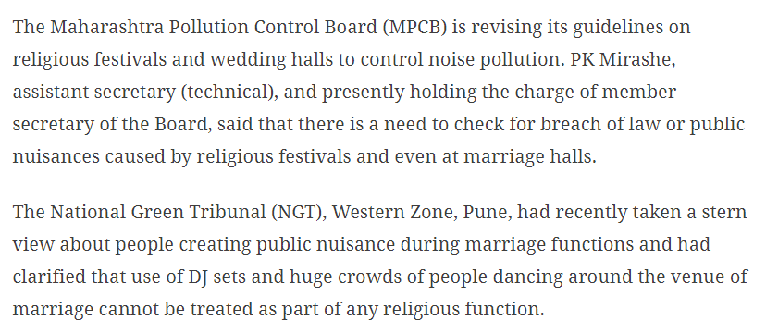
In Maharashtra, …

Slide 24

15) Better design and research :
As a engineer we have responsibility to design better products and bring innovation by applying our knowledge to reduce noise pollution.
Thank You !

Slide 25
References :
https://www.ppsthane.com/blog/how-to-reduce-noise-pollution
https://en.wikipedia.org/wiki/Noise_pollution
https://www.britannica.com/science/noise-pollution
WWW. YOUTUBE . COM
WWW.GOOGLE.COM
https://www.iberdrola.com/sustainability/what-is-noise-pollution-causes-effects-solutions

Slide 26
Quiz
Noise Pollution is also known as,
Environmental Noise
Environmental Pollution
Environmental Sound
Environmental
2) Which of the following is not a source of noise pollution?
Road-traffic noise
Noise from railroads
Talking with a friend
Construction noise
3) Which of the following is India’s noisiest city?
Mumbai
Pune
Delhi
Chennai

Slide 27
Q4) How much is the loudness ( in dB ) when you’re talking to someone?
0 dB
60 dB
100 dB
600 dB
Q5) Which of these is not an effect of noise pollution?
Fatigue
Blood pressure
Sleep disturbance
Stomach ache
Q6) Which of the following noise-levels is unsafe, according to psychologists?
80-100 dB
15-20 dB
60-70 dB
50-70 dB
Q7) Which of the following Act is amended in the Indian Constitution so as to prevent noise pollution?
Noise Pollution Act 1990
Noise Pollution Prevention Act 2012
Noise Pollution Act 2000
Noise Pollution Act 2020

Slide 28
Q8) Which of the following is an ill-effect of noise pollution?
Delayed cognitive development in children
Blindness
Increase in dopamine level
Decrease in Vitamin-D in body

